Slide 1
Kata:
Yinsh Board Representation
Paul Grayson
2013-08-28

Slide 2
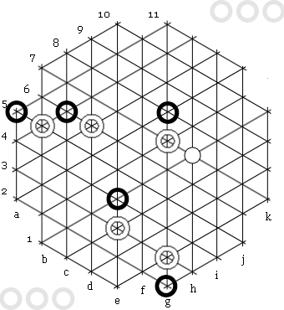
Yinsh
Played on a hexagonal grid
A vertex has five possible states

Slide 3
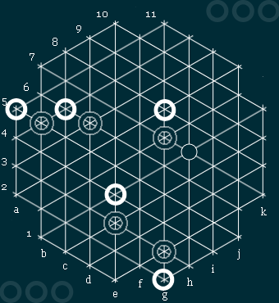
8
(9,8)
i=9

Slide 4
(1,2)
(2,2)
(2,1)
(1,1)
(2,0)
(0,2)

